Slide 1
Fake S100 Energy Meter
Comminucation between Sungrom SGxx series inverter and S100 energy meter

Slide 2
Problem description
Fake S100 Energy Meter
Sungrow SGxxRS inverter fammily can comminucate only with S100 (Sungrow type) energy meter.
This is a special enegy meter which has special address range and slave ID.
The inverter can not recognize the connected power meter because this is the only compatible device (so eventually it is not requiered).
Other problem that the official configuration interface iSolarCloud or WinetS are not capable to setup the energy meter type.
Solution:
We have to emulate the energy meter, we have to fake the answeres and fill out the packages with information. Mostly with zeros and in one case we have to inject the consumed energy.

Slide 3
003F
Fake S100
Raw: fe03003f0001a009
Request from Inverter
SlaveID: FE
Function: 03
Address: 003F
Length: 0001
CRC: 09A0
Response from Meter
SlaveID: FE
Function: 03
Length: 01
Data: 00
CRC: 50AC
Raw: fe03020000ac50

Slide 4
0164 – injected data
Fake S100
Raw: fe03016400081020
Request from Inverter
SlaveID: FE
Function: 03
Address: 0164
Length: 0008
CRC: 2010
Response from Meter
SlaveID: FE
Function: 03
Length: 10 (16 bytes)
Data: xxxxxxxx0000000000000000xxxxxxxx
Raw: fe0310xxxxxxxx0000000000000000xxxxxxxxCRC
DDSU666 - Read 4 word from 2004H
Request
Raw:020320040004CRC
Address:
2004H:high byte P(kW)
2005H:low byte P(kW)
2006H:high byte Q(kW)
2007H:low byte Q(kW)
Response
Raw:020308xxxxxxxxyyyyyyyyCRC
P->x
Q->y

Slide 5
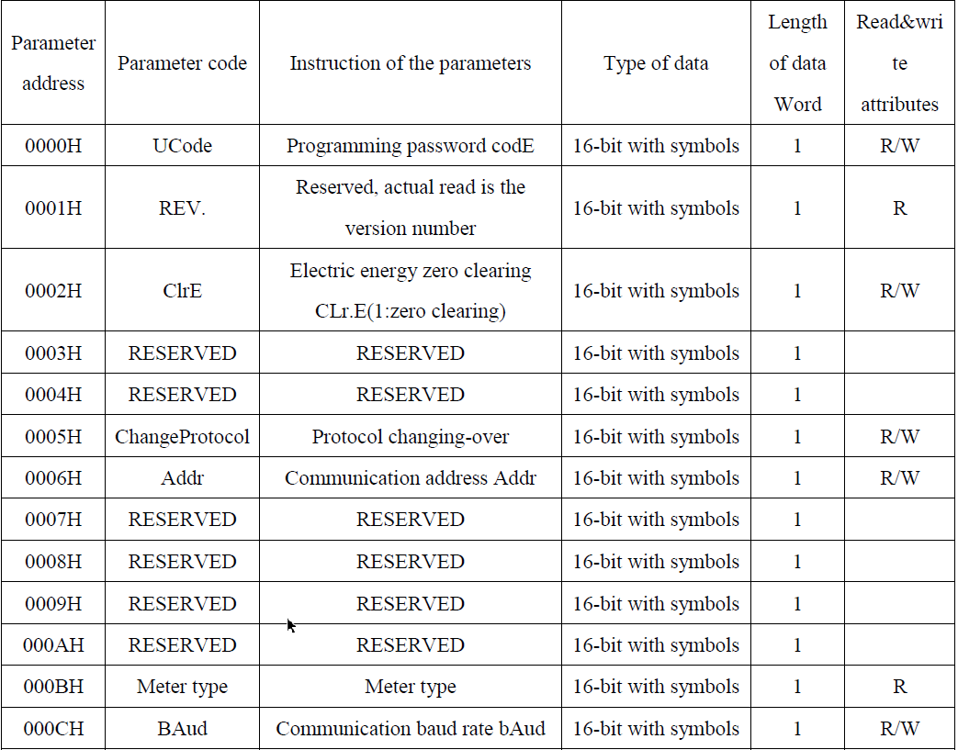
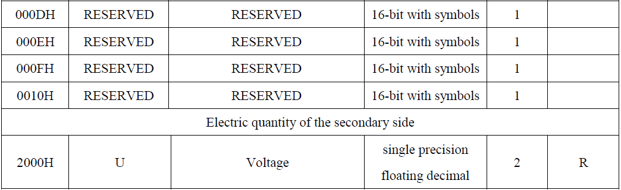
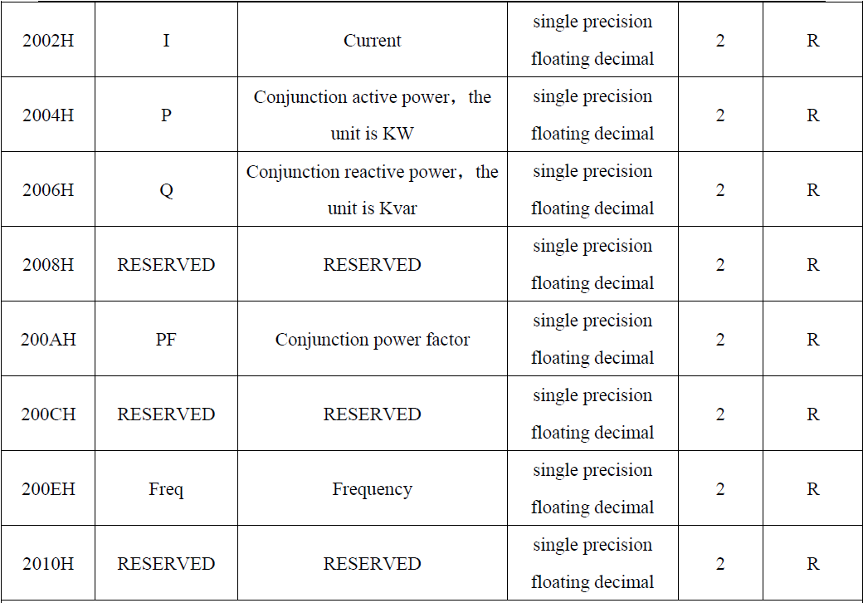
DDSU666 register map
Fake S100

Slide 6
000A
Fake S100
Raw: fe03000a000c71c2
Request from Inverter
SlaveID: FE
Function: 03
Address: 000A
Length: 000C
CRC: C271
Response to
SlaveID: FE
Function: 03
Length: 18
Data: 00000000000000000000000000000000000
Raw: FE03180000000000000000000000000000000000000000000000006F1F

Slide 7
0061
Fake S100
Raw: fe0300610003401a
Request from Inverter
SlaveID: FE
Function: 03
Address: 0061
Length: 0003
CRC: 1A40
Response to
SlaveID: FE
Function: 03
Length: 06
Data: 000000000000
Raw: FE03060000000000006481

Slide 8
0077
Fake S100
Raw: fe0300770001201f
Request from Inverter
SlaveID: FE
Function: 03
Address: 0077
Length: 0001
CRC: 1F20
Response to
SlaveID: FE
Function: 03
Length: 02
Data: 0000
Raw: FE03020000AC50

Slide 9
Timing diagramm
Fake S100
100ms
RX enabled
request received
100ms
request processing
100ms
response sending
TX enabled
RX enabled
request received

Slide 10
References
Fake S100
https://github.com/Linux-RISC/Sungrow-Meter-cheater/blob/Sungrow-Meter-cheater-1.1/cheater.sh

